Slide 2
Domestic Violence Awareness & Support Services
Rhonda Rhodes, President – Hancock Resource Center
Stacey Riley, CEO – Gulf Coast Center for Nonviolence

Slide 3
Gulf Coast Center for Nonviolence
Mission Statement:
To support and serve victims of domestic violence, sexual assault, human trafficking, and family members of homicide victims; educate the community; and act to reduce incidents of interpersonal violence.

Slide 4
Services Provided
Emergency Shelter Services at Two Locations
Counseling (individual & group)
Family Justice Center
Case Management
Court Advocacy Services
Civil legal services
Children's Program, including a Therapeutic Pre-School
Housing Programs
Support for survivors of sex trafficking
Outreach and Awareness
Batterer’s Program (Domestic Violence Intervention Program)
Services to family members and loved ones of homicide victims
Volunteer Program

Slide 5
What is Domestic Violence?
Any incident or pattern of incidents of controlling, coercive or threatening behavior, violence or abuse between those who are or have been intimate partners or family members regardless of gender or sexuality. Domestic abuse isn’t just about violence; it can involve many different types of behavior such as:
Coercive control
Physical abuse
Sexual abuse
Financial abuse
Emotional abuse

Slide 6
01. Coercive Control
The Foundation of Abuse

Slide 7
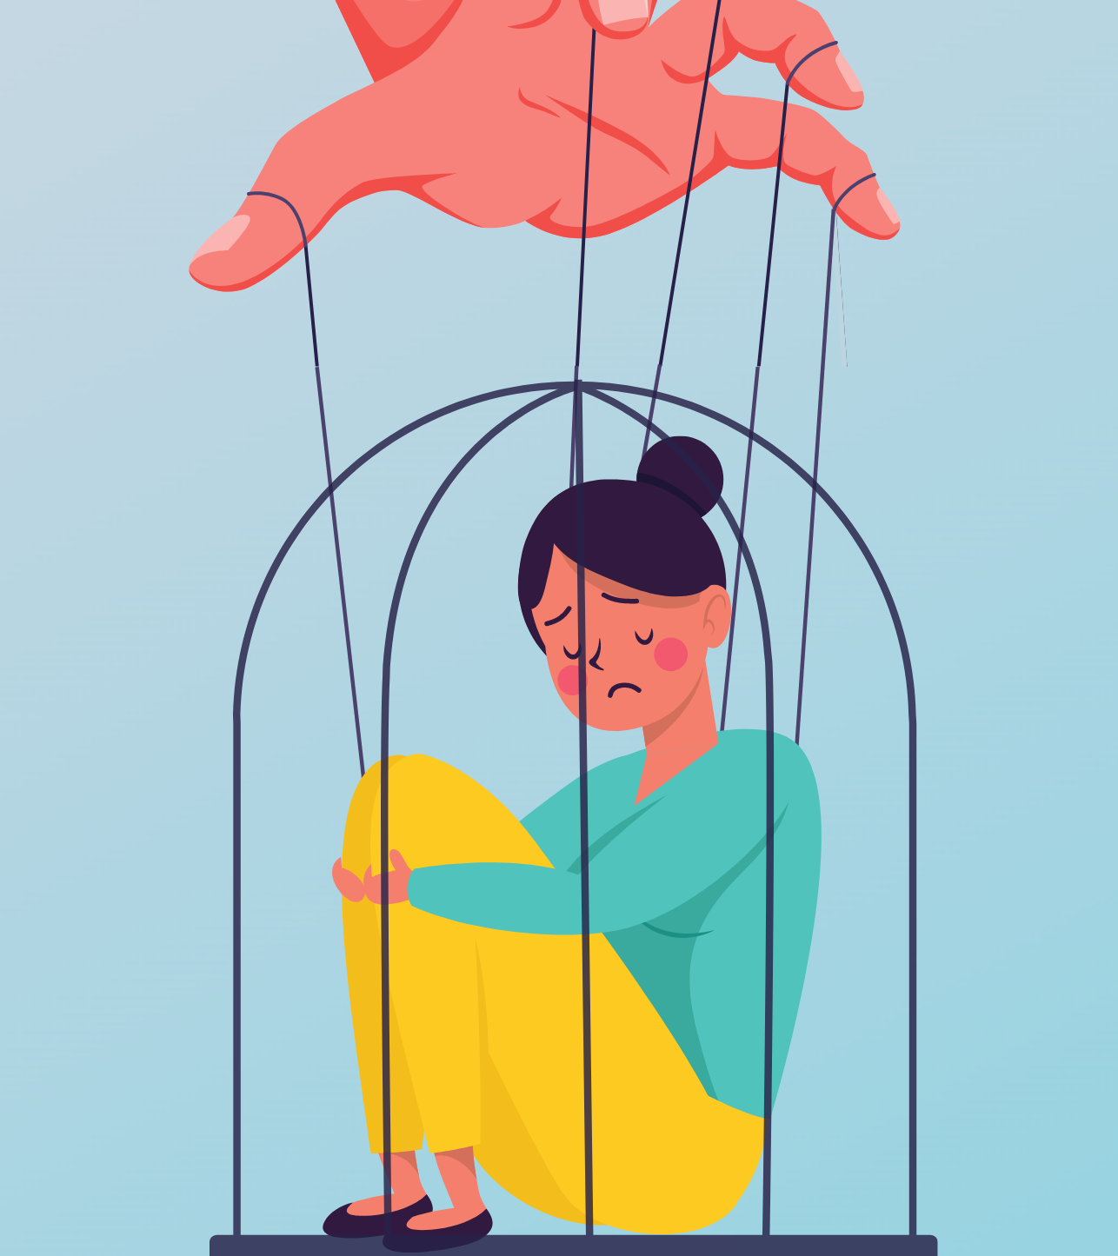
Coercive Control
A pattern of behavior of behavior which seeks to take away the victim’s liberty or freedom and to strip away their sense of self

Slide 9
How do Abusers Gain
Power and Control?
Romance
Love Turns Abusive
Dependence
Whirlwind, fairy tale
Love-bombing
Gain trust and confidence
Safe space to confess secrets, shame, and fears
Jealousy and possession
Laying foundation for sets of rules
Critical of what “makes you, you.”
Merging finances
Isolation from friends and family
Surveillance

Slide 10
Tools to Maintain Power and Control
Coercion and Threats
Emotional Abuse
Intimidation
Isolation
Minimizing, Denying, Blaming
Using Children
Economic Abuse
Male Privilege

Slide 11
Abusers don’t use violence because they have lost control of themselves

Slide 12
Abusers use violence when they’ve lost control of their partner.

Slide 13
02 . Trapped in Abuse
How Abusers Make it Difficult to Leave

Slide 14
Forged Dependence
Financial abuse leaves the victim without access to money
Isolation keeps the victim from family and friends.
Children being used as leverage keeps the victim from leaving.
Constant surveillance leaves the victim unable to reach out for help

Slide 15
Romance & Love Still Plays a Role
The victim wants the relationship to work.
There are good times.
There are moments of reminiscing on “the good days.”
After the abuser causes trauma, instead of taking accountability for causing the trauma, the abuser will frame it as a hardship they have overcome as a couple

Slide 16
GASLIGHTING is a subtle form of emotional manipulation that often results in the recipient doubting their perception of reality.

Slide 17
03 . The Danger Zone
Signs that an Abusive Relationship
Could Turn Fatal

Slide 18
Signs that a Relationship Could be Fatal
Abuser has used or threatened to use a weapon again victim.
Abuser has threatened to kill victim or victim's children.
Abuser has attempted to strangle or has strangled the victim in the past.

Slide 19
Signs that a Relationship Could be Fatal
Strangulation – pressure on the neck by any means. Increases homicide risk by 700%
Gun ownership – If there is a gun in the home, the homicide risk increases by 500%

Slide 20
034. Breaking the Cycle
How to Escape and Where to Find Help

Slide 21
Leaving is a Process, not an Event
It’s different for everyone
Leaving is dangerous
Only the victim can make that decision
Takes considerable community support, empathy, and patience from friends and family
A victim will not leave until ready to leave
It’s painful to learn that sometimes love requires boundaries.

Slide 22
First Steps to Freedom
Fighting Isolation
Safety Planning
Connecting with Victim Services

Slide 23
What is Human Trafficking?

Slide 24
HUMAN TRAFFICKING is the act of recruiting, harboring, transporting, providing, or obtaining a person for labor services or commercial sex acts through force, fraud, or coercion; for the purpose of exploitation, involuntary servitude, peonage, debt bondage, or slavery. It includes any commercial sex involving a minor. People who are subjected to involuntary servitude are held against their will and forced to work, frequently under the threat of violence to themselves or their families.
HUMAN TRAFFICKERS prey on those who become disadvantaged – even temporarily – due to age, social abandonment, economic hardship, disasters, emergencies or criminal activity. The demand for cheap labor drives the market for human trafficking victims.

Slide 27
The Indicators
Shows signs of having been denied food, water, sleep, or medical care?
Is the person living in unsuitable conditions?
Lack personal possessions and appear to not have a stable living situation?
Inability to leave home or place of work.
Acts fearful, timid, or submissive?
Inability to speak for oneself or share's one's own information.
Appears to be coached on what to say.
Has bruises or other injuries in various stages of healing?
Has no identification documents (ID or passport)

Slide 28
How do you help?

Slide 29
Understand the Normal Behaviors in Adults Who Have Experienced Trauma
Difficulty remembering things
Shutting Down
Irritability
Defensiveness
Emotional Numbness
Substance use/abuse
Self-neglect
Experience trauma bond with abuser/trafficker
Untrusting of law enforcement or other helping professionals

Slide 30
Practice the Guiding Principles of Trauma Informed Care
Safety
Survivors should feel physically and emotionally secure in the environment. Create spaces that are welcoming.
Collaboration and Mutuality
Clients should have an active role in the decision making and outcomes. Let them be the expert in their lives.
Trustworthiness & Transparency
Do what you say you are going to do even in difficult situations.
Empowerment, Voice, and Choice
Give survivors a voice and a choice in their care. Involve survivors in decision-making process and respect their right to self – determination.
Peer Support
When possible, connect clients with other individuals who have had similar experiences
Sensitivity & Understanding
Shift the question from "What's wrong with you?" to "What happened to you?"

Slide 31
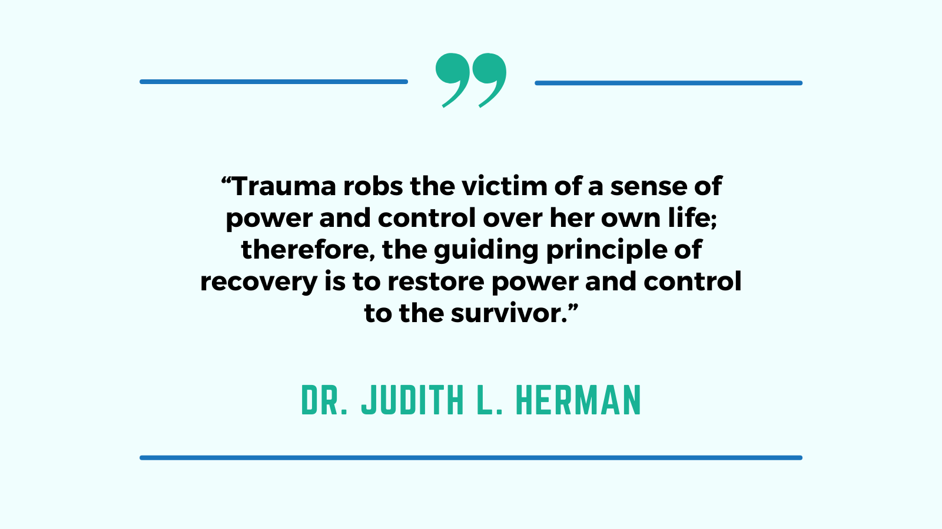

Slide 32
Questions?

Slide 33
Hancock Resource Center
Executive Director: Rhonda Rhodes

Slide 34
Mission
Hancock Resource Center works to stabilize families and strengthen the community by addressing obstacles and barriers to housing and coordinating services for families in need.

Slide 35
Hancock Resource Center Overview

Slide 36
HRC Programs
HUD Housing Counseling
Supportive Services for Veteran Families (SSVF)
Veterans' Administration Grant per Diem (GPD)
Homeless Veteran Reintegration Program (HVRP)
Transitional Housing for Domestic Violence Survivors
Family Navigator Advocacy Program
Owner-Occupied Rehabilitation
Living in Place Program
Youth Programs
Hancock Youth Leadership Academy, Hancock Youth for Positive Efforts
Disaster Response and Recovery
Community Assistance Programs
Holiday Assistance
Emergency Assistance

Slide 37
Confidentiality
Survivor case information is to be compartmentalized.
VAWA Compliant Database
Most Client Management Systems are noncompliant
Data may not be entered into HMIS
ESG Providers must have alternate method to submit billing.
Physical Files/Content
Secured away from other program files
May only contain what survivor consents to
Informed Consent/Release of Information

Slide 39
Violence Against Women's Act
Originally enacted in . Added Housing Protections in 2005 but enhanced with the 2022 Reauthorization.
Expands definition of "covered housing programs"
Housing Protection and Role of Housing Counselor directly sourced from HUD:
https://www.hudexchange.info/trainings/courses/vawa-housing-services-series/4890/

Slide 40
Housing Protections
Adverse decisions regarding housing assistance because of VAWA violence/abuse committed against survivor or related to VAWA violence/abuse
Denial of admission or assistance
Eviction and termination of assistance
Emergency transfers
Lease bifurcation
Right to report
Self-certification (may use Form HUD-5382)
Cannot require specific documentation

Slide 41
Housing Protections (continued)
Housing providers cannot deny admissions or assistance, evict, or terminate assistance to someone affected by VAWA violence/abuse because of:
VAWA violence/abuse committed against them
Reasons related to VAWA violence/abuse (e.g., eviction history, bad credit history, criminal history)
Survivors must have the option to stay even if there has been criminal activity directly related to VAWA violence/abuse
Protections apply to residents, tenants and household members
HUD refers to these protections as VAWA’s “core” housing protections

Slide 42
Role of the Housing Counselor
Understand clients’ goals and experiences
Recognize when VAWA housing protections might be available to a client
Educate clients on VAWA housing protections
Assist survivors in making requests related to VAWA housing protections
Support survivors in filing fair housing complaints with FHEO
As appropriate, advocate for survivors with housing providers
Identify appropriate referrals for supportive or legal services
Source: HUD Exchange

Slide 43
Assisting those experiencing domestic violence
Written policies and procedures in place
Train staff how to respond to survivors – Trauma informed approach, confidentiality
Determine the survivor's needs – housing or shelter, medical attention, food, counseling, victim services, legal, etc.
Make appropriate referrals – have a referral binder
Survivor-driven action plan
Safety plan

Slide 44
Safety Planning
A safety plan is a set of actions that can help lower a survivor's risk of being hurt by their partner. It includes information specific to the survivor and his/her life that will increase their safety at school, home, and other places they go regularly.
National Domestic Violence Hotline (www.thehotline.org) - Online Interactive Safety Planning Tool
Technology Safety Plan:
Tech Safety App – educational resource app
DocuSafe – free app that allows survivors to collect, store, and share evidence of abuse

Slide 45
Housing Challenges
Affordable housing shortage
Credit – past evictions, outstanding utility bills, etc.
Criminal history
Low or no income

Slide 46
Transitional to Permanent Housing
Transitional housing programs– provides supportive, yet temporary, accommodations meant to bridge the gap from homelessness to permanent housing. Offers supportive services designed to help the survivor become more empowered and move toward independence.

Slide 47
Empowerment through Voluntary Services
Survivor-Driven
Education
Employment Counseling
Budgeting
Goal Setting/Action Plans
Connect with Resources: legal, counseling, etc.
Advocacy

Slide 48
Connect with HRC

Slide 49
Presenters
Stacey Riley, CEO
Gulf Coast Center for Nonviolence
213 Porter Ave.
Biloxi, MS 39530
228-436-3809
sriley@gccfn.org
Rhonda Reid, President
Hancock Resource Center
454 Highway 90, Suite B.
Waveland, MS 39576
Phone (228) 463-8887
rrhodes@hancockhrc.org

